Slide 1
Fraud Scenarios
Deloitte will review ClaimCenter configurations as well as deploy analytical and data mining tools for the homeowner LOB to identify other potential causes of fraud. Deloitte will analyze current authorization settings related to claim payments (e.g., vendor payments, manual check payments, and ClaimCenter payments). Our focus will be on similar fraud types as identified by the organization over the last 12 months
9/25/2018

Slide 2
Multiple claims to same party/vendor
#1
Payments are made to a similar party multiple times for different claims. The same address for claimants and vendors are entered differently such that they are not all matched together.
Duplicate claims of the same amount.
Method of analysis:
We rollup the claim payments for each claimant and identify duplicate/close amounts for the same claim/type of loss within a short interval of time. We will also perform fuzzy matching to identify if same claimant has been claiming for similar causes.

Slide 3
Advisory Allowance Fraud
#2
If the Insured is a general contractor who is working with 3-4 types of subcontractors, adjusters are allowed to bump the claim amount by a certain % as an advisory allowance. There is an abuse in these types of claims.
Method of analysis –
The adjuster is doing it more often than others. Identify this by the frequency distribution of the adjuster.
Also check if the adjuster is doing it for a specific insured or small group of insureds (multiple times)

Slide 4
Authority level fraud
#3
Some adjuster privileges are changed immediately following catastrophes (hurricanes, tornadoes, floods, etc.) that occurred.
Adjuster is behaving differently in handling catastrophe claims which he/she normally wouldn’t do.
Method of analysis –
Compare payment distribution of each adjuster against the other adjusters in that region and see the deviation from their allowance limit
Compare payment distribution by adjuster before and after catastrophe, or prior catastrophes (within a 1-3 year window)

Slide 5
Manual payments fraud
#4
Manual checks are made without any management approval or with limited approval/sign-off.
Manual checks are deliberately made to the wrong parties.
Method of analysis:
Transactions per claim handler – assuming a similar caseload, any noticeable changes in average transactions (i.e checks cut) can raise a flag.
For every adjuster, compare the count and volume of manual payments made against others for similar cases.
Named parties in checks and Insured names should be same.

Slide 6
Property schemes
#5
HO insurance claims opened for properties that never existed.
Loss amounts are deflated
Property are intentionally damaged or destroyed to gain insurance benefits.
Method of analysis:
Look at the distribution of a type of loss, and see if the average claim values vary by much (evident by a standard deviation). Identify claims within these types of losses that are 2 or 3 s.d. away from the mean, and determine if they come from specific adjusters.
Average severity of each claim handler’s caseload – with adjustments to exclude large losses (i.e. total loss on homes).
Rely on public database of property owners with insured names on policy and named on checks

Slide 7
False Claims
#6
Falsifying cause of loss. Example : Roof leakage problem and claiming for theft or fire
Method of analysis:
Use clustering to identify similar claims using text analytics and payments made for specific claims. Outliers could be indicators of fraud activity.

Slide 8
Anomaly Detections
#7
A claimant claiming for vastly different values. For example an individual claiming for a very luxury car who usually claims for budget cars.

Slide 9
Adjuster overpaying the insured within their authorization limit
#8
Method of analysis
Find the differences between the claim amount, paid amount and authorization limit for each claim and identify frequent differences.

Slide 10
Damage incurred outside the coverage period
#9
Method of analysis
Identify cases that have been reported 15 days before or after the policy expiration date, or identify claims that were incurred within days of the policy expiration date

Slide 11
Other Scenarios/ Important features
#10
Time lag in reporting – days between date of loss and report date
Litigation/Attorney involvement
Number of claims guidelines/rules broken
Number of claims made by insured in recent number of years (1-5 years)

Slide 12
Sample/ Generic Modeling Techniques

Slide 13
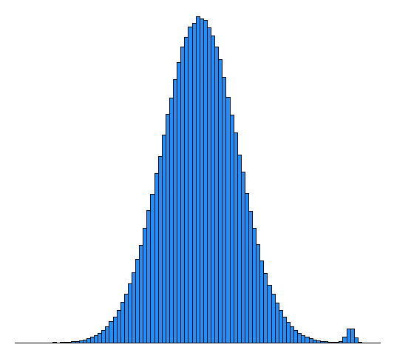
Application of GMM
Assumptions :- Fraudulent claims and legitimate claims are coming from 2 different gaussian curves for a same cause

Slide 14
Neural Network Application
Based on bills, detect what kind of damage and check whether the reported is same or different. In case of difference chances of fraud cases is high.

Slide 15
Clustering techniques

